Slide 1
Taxonomic Profiling Analysis
nf-core/taxprofiler Pipeline Results
Glen Rogers & Chirayu Patel

Slide 2
Pipeline Overview
nf-core/taxprofiler
Standardized Nextflow pipeline for taxonomic classification and profiling of shotgun metagenomic data
14
3
1.3M
Samples
Classifiers
High-Quality Reads
QC Tools
Alignment
Taxonomic
FastQC, fastp
bowtie2, Samtools
Kraken2, Centrifuge, Kaiju

Slide 3
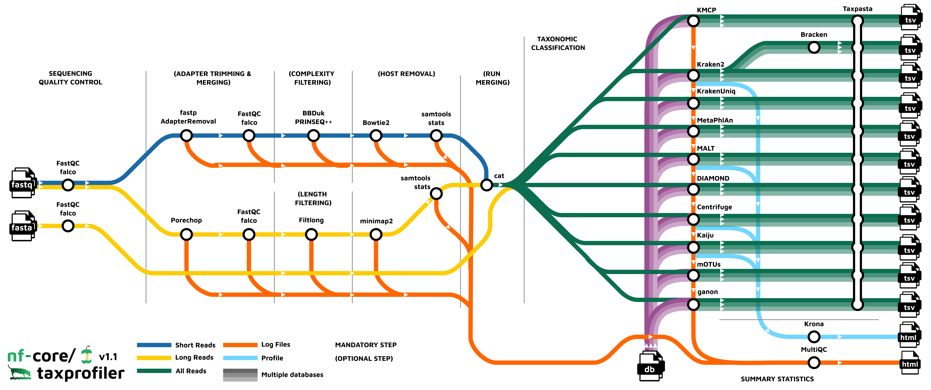

Slide 4
Quality Control Results
151 bp
Input Read Length
Read Processing
Adapter trimmed: 62.8%
45-47%
Reads passing filter: 99.4%
Q30 bases: 94.9%
GC Content
Final length: ~106 bp
0.5%
Excellent data quality with minimal loss during filtering
Duplication Rate

Slide 5
Kraken2 Classification Results
k-mer Exact Matching: Ultra-fast classification using exact k-mer hashing with LCA assignment against NCBI RefSeq
Detected Species
Homo sapiens
~0.024% of reads (~304 reads)
Saccharomyces cerevisiae
Trace amounts detected
Top 5 Species: Account for ~0.027% of total reads

Slide 6
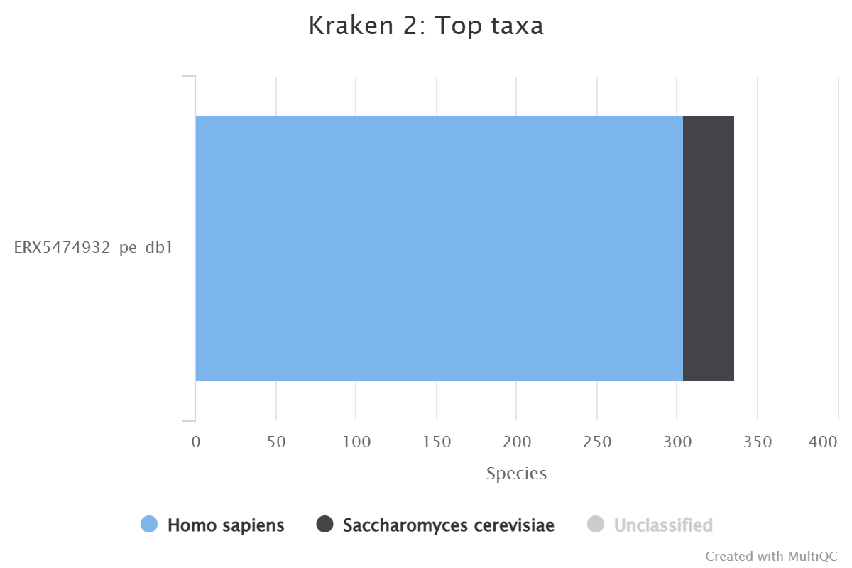

Slide 7
Centrifuge Classification Results
FM-Index Compression: Memory-efficient classification using Burrows-Wheeler transform with compressed RefSeq genomes
Detected Species
Eucommia ulmoides
~0.22% of reads (Chinese rubber tree)
Homo sapiens
Trace amounts detected
Top 5 Species: Account for ~0.2-0.25% of total reads

Slide 8
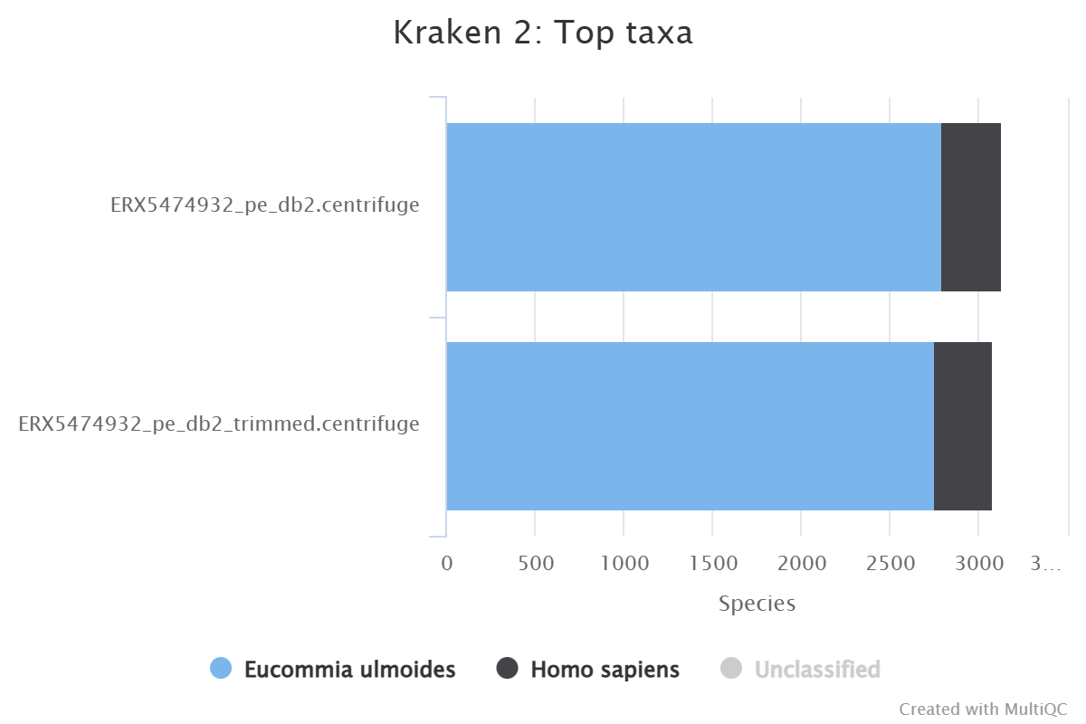

Slide 9
Kaiju Classification Results
Protein-Level Search: Sensitive classification using translated 6-frame protein search against NCBI nr database
Classification Status
Assigned Reads
0.0% at species rank
Analysis Note
No species-level classifications at current stringency threshold
Recommendation: Try lower stringency or higher taxonomic ranks (genus/family)

Slide 10
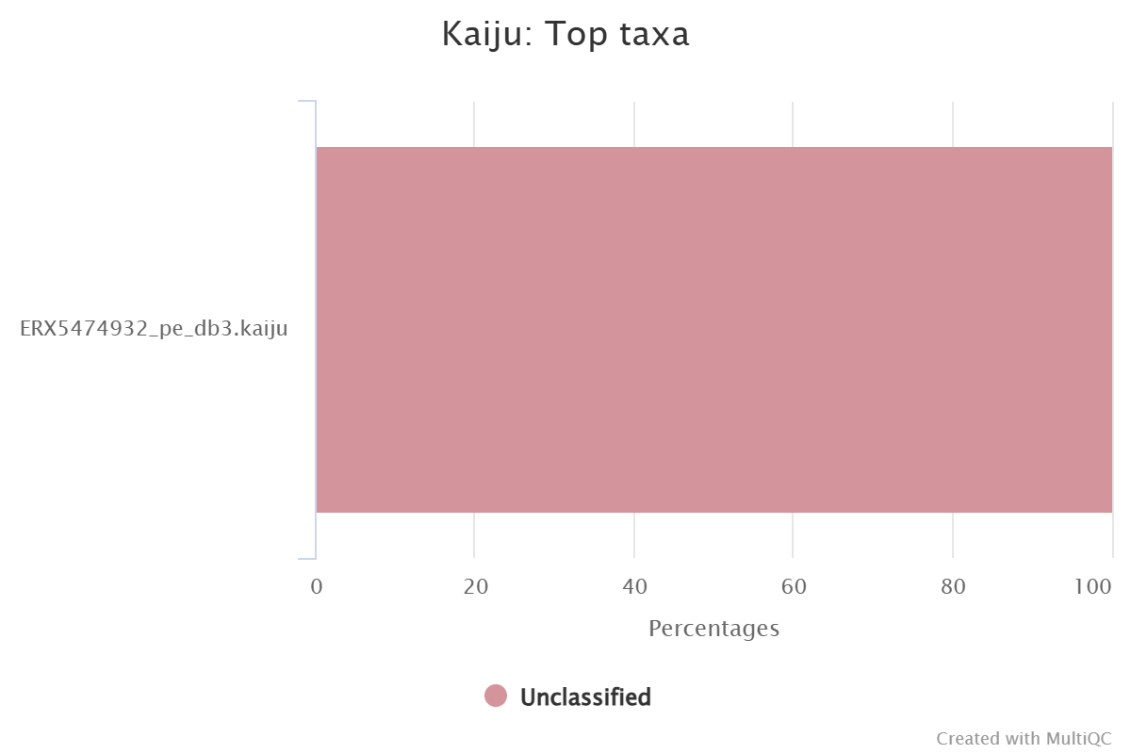

Slide 11
Kraken2 vs Centrifuge vs Kaiju
ADVANCED nf-core Implementation: Three complementary classifiers optimized for different detection scenarios
Kraken2
Centrifuge
Kaiju
k-mer Exact Matching
FM-Index Compression
Protein-Level Search
Algorithm: Exact k-mer hashing with LCA assignment
Algorithm: Burrows-Wheeler transform with FM-index
Algorithm: Translated 6-frame protein search
Database: NCBI RefSeq/nt genomes
Database: Compressed RefSeq genomes
Database: NCBI nr protein sequences
Speed: Ultra-fast (millions of reads/min)
Speed: Very fast (high throughput)
Speed: Moderate (protein search overhead)
Memory: High (50-200GB typical)
Memory: Low (8-16GB typical)
Memory: Moderate (30-60GB typical)
Best For: Known genomes, rapid screening
Best For: Limited resources, broad surveys
Best For: Divergent sequences, viruses
Most sensitive to database coverage
Memory-efficient for large databases
Detects distantly related organisms
nf-core Strategy: Parallel execution of all three tools maximizes detection across sequence divergence levels, database biases, and computational constraints

Slide 12
Taxonomic Classification Results
Detected Organisms: Multiple species identified across three independent classification methods
Kraken2
Centrifuge
Kaiju
Homo sapiens
Eucommia ulmoides
~0.02% of reads
~0.22% of reads
Protein-level analysis
Saccharomyces cerevisiae
Homo sapiens
No species-level assignments at current stringency
Trace amounts detected
Trace amounts detected
Key Species Detected
Human (Homo sapiens), Chinese rubber tree (Eucommia ulmoides), Baker's yeast (Saccharomyces cerevisiae)

Slide 13
Host Genome Alignment
Analysis Implications
1%
No host contamination detected
Possible reference genome mismatch
All reads available for taxonomic analysis
Alignment Rate
bowtie2 to host reference
Verify host reference genome matches experimental design

Slide 14
Key Findings
Excellent Quality
Species Detected
High-quality sequencing with 94.9% Q30 bases and 99.4% reads retained
Human, Chinese rubber tree, and yeast identified across tools
Identified Organisms Summary
Data Quality
Detected Species
Input: 151 bp paired-end reads
Homo sapiens (Human)
Output: 1.3M filtered reads
Eucommia ulmoides (Plant)
Low duplication (0.5%)
Saccharomyces cerevisiae (Yeast)
Multiple species identified with complementary classification methods detecting human, plant, and fungal sequences

Slide 15
Next Steps & Analysis
Characterize Detected Species
Expand Classification
Confirm human DNA source and concentration
Lower stringency thresholds for more hits
Investigate Eucommia ulmoides presence
Try genus and family level classification
Assess yeast contamination significance
Use expanded reference databases
Functional Analysis
Assembly Approach
Annotate genes for detected species
De novo assembly for novel sequences
Perform metabolic pathway analysis
Bin contigs by taxonomic affinity
Compare functional profiles across samples
Reconstruct population genomes
Focus: Investigate the biological significance of human, plant, and fungal sequences in sample context

